Slide 1
Career Planning
Pathways to your career
Box Hill Institute's Skills and Jobs Centres were supported by the Victorian Government

Slide 2
Career Topics
3. Understanding job prospects for the future
1. Identifying my areas of interests
2. Matching interests with opportunities
4. Pathways to getting your dream job
Pictures courtesy of Google images
Box Hill Institute's Skills and Jobs Centres were supported by the Victorian Government

Slide 3
Pictures courtesy of Google images
How do I know what job I want to do?
Box Hill Institute's Skills and Jobs Centres were supported by the Victorian Government
Notes:
Some people are born knowing what they would like to do and others don’t have a clue. A good way to find out is to become a Career Investigator!

Slide 4
Investigating the right career path for you can be fun!
Career Researching Tips
Job Outlook– jobs are listed alphabetically
Bullseye charts – these list job according to level and occupation
Investigate job boards like Seek – which jobs make you feel excited?
Attend career expos’
Research course guides or use Skills Gateway
Talk to people you know – what jobs do they do?
Talk to people who work in a job you would like to do – how did they get there?
Consider taking a career personality test - what occupations you would suit?
Make an appointment with a Career Counsellor for 1:1 guidance
Pictures courtesy of Google images
Box Hill Institute's Skills and Jobs Centres were supported by the Victorian Government
Notes:
These are some great ways to investigate careers that you may enjoy.

Slide 5
What Career would I suit?
Food & Tr
Pictures courtesy of Google images
It & Office jobs
Helpers
Hospitality& Travel
Animal Lovers
The Creatives
Trades & Hands On
Pictures courtesy of Google images
Box Hill Institute's Skills and Jobs Centres were supported by the Victorian Government
Notes:
Most people can probably identify with an area that they have more passion or flair for – like some of these areas and jobs.

Slide 6
Are you “Hands on”?
Like tools
Prefer working outdoors
Getting your hands dirty
Sounds like a trade is best suited to you…
Horticulture
Warehousing/Transport and Logistics
Business/Operational Management
OH&S Officer
Electrotechnology
Building and Construction
Civil Construction
Landscaping
Plumbing
Consider doing an apprenticeship!
Box Hill Institute's Skills and Jobs Centres were supported by the Victorian Government
Pictures courtesy of Google images

Slide 7
A Passion for Flare and Creativity?
Like to create and design
Be a “tradie” but not get your hands dirty
Have a “passion for fashion” and the current trends
Enjoy colour, flare and the latest ‘edge”
Have you considered:
Hair and Beauty
Floristry
Graphic Design
Interior Design?
Pictures courtesy of Google images
Box Hill Institute's Skills and Jobs Centres were supported by the Victorian Government

Slide 8
How can I help you?
Want to change someone's life?
Wanting to work with people that are in need?
Are you a caring and nurturing person
Have personal experiences and just want to help others?
A career in the community sector sounds like it’s the place for you!
Health and Fitness
Working with the elderly
Counselling & social work
Children’s services
Working with youth
Teaching
Nursing and health services
Providing quality customer service
Working with people with a disability
Pictures courtesy of Google images
Box Hill Institute's Skills and Jobs Centres were supported by the Victorian Government

Slide 9
Who doesn’t like food and travel?
Thought about being the next Master Chef?
Want to improve your already impressive culinary skills?
Wanted to work behind a bar or in gaming and just don’t know where to start?
Prefer to cook dessert?
Love to travel and see the world?
Want to feel worldly but not leave your seat?
A career in Hospitality or Tourism could be for you!
Commercial cookery
Patisserie
Hospitality worker
Hospitality Management
Event Management
Travel & Tours Officer
Pictures courtesy of Google images
Box Hill Institute's Skills and Jobs Centres were supported by the Victorian Government

Slide 10
Nothing wrong with a desk job!!!!!
Do you:
Pictures courtesy of Google images
Feel like you have fantastic customer service skills and experience?
Love numbers?
Enjoy the challenge that computers can pose?
Feel you can handle certain levels of stress?
Have fantastic communication skills?
Like to organise, organise, organise?
Want to earn whilst not going anywhere?
Like to have fun in a busy industry?
Consider:
Administration,
Accounting,
IT
Cyber Security
Human resources
Box Hill Institute's Skills and Jobs Centres were supported by the Victorian Government

Slide 11
Why work with humans when you can work with animals!?!
Love animals and would do anything for them?
Feel passionate about helping and assisting others?
Are you interested in grooming them and making them look all cute?
Prefer to train animals?
Want to work within a vet, sanctuary, shelter or even zoo?
Animal studies are for You!
Consider :
Vet nursing
Pet grooming
Animal technology
Captive Animals
Equine studies
Pictures courtesy of Google images
Box Hill Institute's Skills and Jobs Centres were supported by the Victorian Government

Slide 12
Keeping up with future Job Prospects
Pictures courtesy of Google images
Box Hill Institute's Skills and Jobs Centres were supported by the Victorian Government

Slide 13
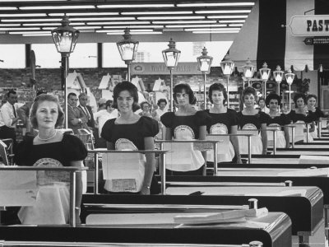
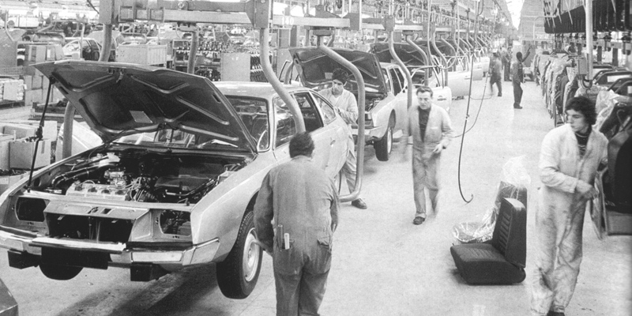
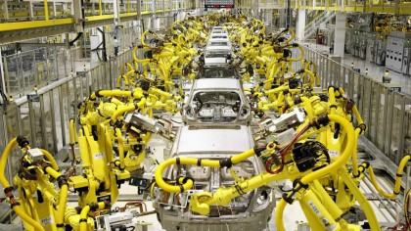
Technology takes some jobs away…
Pictures courtesy of Google images
Box Hill Institute's Skills and Jobs Centres were supported by the Victorian Government
Notes:
It is important to keep up with what is happening with jobs – because unfortunately with technology and offshoring some jobs can get taken over by a machine or moved to a country with cheaper labour costs.

Slide 14
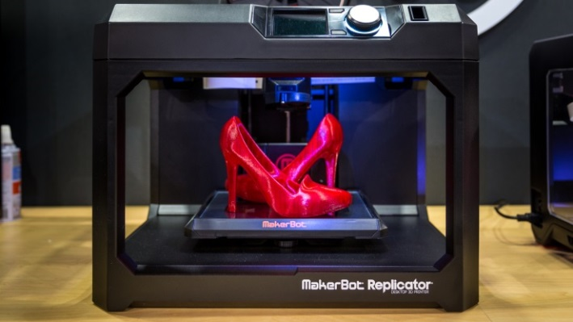
Technology makes new jobs
3D Printing
Cybersecurity
Digital marketing
Biosecurity
Pictures courtesy of Google images
Box Hill Institute's Skills and Jobs Centres were supported by the Victorian Government
Notes:
Cyber Security is an area set to grow this is about protecting computers, data and systems from attack by unlawful users or viruses. You might have heard about big govt databases being hacked. Banks, defense forces are always having to have high security measures. Cyber security is an area set to grow very rapidly in the next few years. Remember Census night.
3D printing is also on the increase and effects a whole range of existing business such as dental labs, it is being used to produce a whole range of areas of production from making dental plates, prosthetics, food, plumbing equipment etc. People will need to understand about design in their areas of work as well as there will be the need for technicians who can build design and operate this equipment.
​​​​​​​​​​​​​​​​​​Biosecurity is a critical part of the government's efforts to prevent, respond to and recover from pests and diseases that threaten the economy and env​ironment.
Airtasker, Air bnb, Uber have created new ways to earn money using a computer or smartphone.

Slide 15
New IT & Programming Jobs
http://www.remingtoncollege.edu/uploadedImages/Programs/ElectronicTechnology/electronics-
Box Hill Institute's Skills and Jobs Centres were supported by the Victorian Government
Pictures courtesy of Google images
Notes:
Since Technology is always increasing, the need for people to design, repair and maintain equipment are areas which are destined to have high growth.

Slide 16
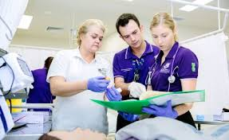
Top 5 growth areas for the near future
According to https://cica.org.au/wp-content/uploads/Employment-Outlook-to-November-2019.pdf
1. Hospitality
2. Education
4. Construction
3. Health Sector
5. Architecture, Engineering & Technical Services
Pictures courtesy of Google images
Box Hill Institute's Skills and Jobs Centres were supported by the Victorian Government

Slide 17
Top 20 Occupations – ranked by projected growth to November 2019
General Clerks
Sales Assistants
Registered Nurses
Aged & Disabled Carers
Accountants
Child Carers
Education Aides
Retail Managers
Chefs
Carpenter & Joiners
Waiters
Checkout Operators & Office Cashiers
Truck Drivers
Inquiry Clerks
ICT Managers
Software & Applications
Primary School Teachers
Gardner's
Kitchenhands
Electricians
Box Hill Institute's Skills and Jobs Centres were supported by the Victorian Government
Pictures courtesy of Google images
Notes:
Most of these jobs are learnt at either a certificate, diploma, apprentice, traineeship or on the job learning.

Slide 18
Job prospects are important to consider too
Is there going to be jobs in this area in the future?
How much do people earn in this job?
What hours do people work in this job?
What skills are important to have in this job?
How do I become qualified to do this job?
How long will it take?
Is there room to grow in this job?
Does this job fit in with my other goals and considerations?
http://joboutlook.gov.au/occupation.aspx?search=alpha&tab=prospects&cluster=&code=4221

Slide 19
Career Pathways
Certificates –3 -12 months
Diplomas – 1 – 2 years
Traineeships – 1year
Apprenticeships – 3+ years
Degrees – 3+ years
Voluntary work
Student Placement
=
JOB you LOVE
Pictures courtesy of Google images
Pictures courtesy of Google images
Box Hill Institute's Skills and Jobs Centres were supported by the Victorian Government
Box Hill Institute's Skills and Jobs Centres were supported by the Victorian Government
Notes:
There are many ways to get into the type of job you would like.
Certificates and Diplomas can be undertaken at Tafe institutes and can get you into the workforce faster than a degree.
They generally require less study, have a workplacement component or are part of a paid apprenticeship.
People who do certificate and Diploma courses can start earning money faster and gain industry experience. If they want to they can continue studying at higher levels whilst working or enter a pathway into a higher education course, you may have even obtain credit for your Adv Diploma as Tafes have pathway arrangements with specific universities for this level of course.
Did you know that quite a few TAFES have their own higher Ed course - Bachelor & Post Grad courses – Advantages: smaller class groups, more personalised attention and vocationally focused
Voluntary work and student placement are great ways to test an industry, gain experience and get references to put on your resume.
How is Tafe different to University?
University study is very research-based and focused on learning the theory behind the practical knowledge, whereas TAFE offers more practical skills, getting you out in industry and often learning on-the-job (with an apprenticeship, for example).
If you are deciding which is best for you, think about what you want to get out of the education experience and also think about your learning style. If you love jumping into a library and reading, discussing ideas and theory, then university will suit you. If you need to be more hands-on and like to do things in order to learn about them (what is called kinaesthetic learning), then you will get more out of TAFE.
TAFE qualifications can also vary from certificates and diplomas which you undertake when completing apprenticeships (these will get you on the track for a career as a mechanic, carpenter, electrician, hairdresser or baker to name a few) or traineeships (in accounting, aged care, building and construction, dental assisting, logistics and tourism, for example).

Slide 20
How can I career plan for a Job of the Future?
Learn what occupations exist and review their future prospects
http://joboutlook.gov.au/alpha.aspx
2. Narrow down your areas of interest – Top 3
3. Understand the study / time commitments it takes to learn a job
http://www.skills.vic.gov.au/victorianskillsgateway/Pages/Home.aspx?Redirect=1#/SitePages/Home.aspx
4. Review against your own availability
5. Consider entry level roles which allow you to gain work faster
6. Take a volunteer position in area of interest to gain experience & references
https://govolunteer.com.au/volunteering/in-melbourne-vic-3000?keyword=couns&radius=40
7. Make an appointment with a Skills and jobs Centre for Career Advice!
Box Hill Institute's Skills and Jobs Centres were supported by the Victorian Government

Slide 21
CBD ELGAR
Ground Floor Box Hill Institute
21 Degraves St 465 Elgar Road
Melbourne, 3000 Box Hill, 3128
P: 03 8892 1360 P: 03 8892 1350
E: SAJC.CBD@boxhill.edu.au E: SAJC.Elgar@boxhill.edu.au
LILYDALE
John Street Campus
34-40 John Street
Lilydale, 3140
P: 03 8892 1370
E: SAJC.Lilydale@boxhill.edu.au
www.boxhill.edu.au/skills-and-job-centre/
Box Hill Institute's Skills and Jobs Centres were supported by the Victorian Government

